Slide 1
Meta-learning Methods
CS771: Introduction to Machine Learning
Purushottam Kar

Slide 2
Meta Learning Methods
A collection of techniques that are not specific to any particular machine learning algorithm or task
Can be applied to several (all) machine learning tasks, algorithms in general
Hence the name “meta-learning”
Include techniques for hyperparameter tuning, model selection, reducing bias and variance, etc.
These problems are faced by all machine learning problems and algorithms in some form or the other

Slide 3
Model Selection
Notion of models and model parameters in ML terminology
Model selection and hyperparameter tuning strategies
Notions of bias and variance, overfitting and underfitting
Bias-variance trade-offs and generalization error

Slide 4
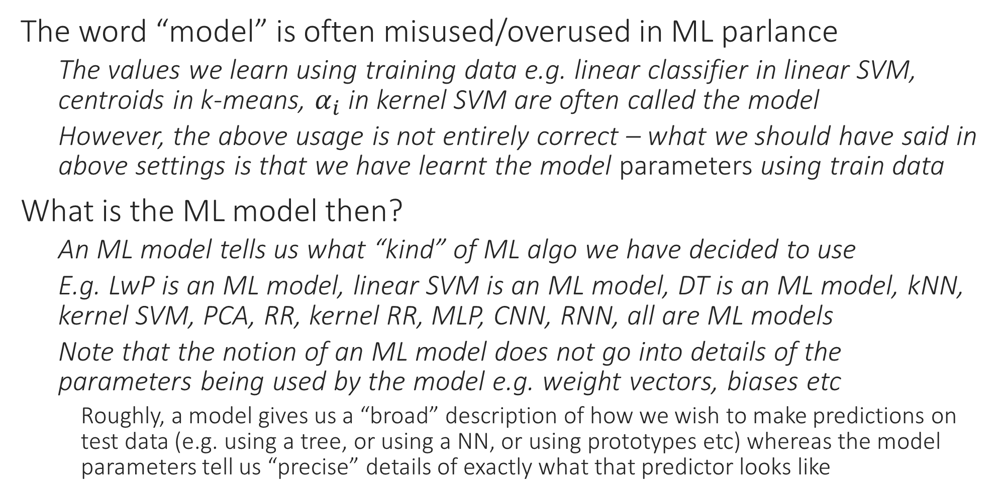
Models in Machine Learning
The word “model” is often misused/overused in ML parlance
The values we learn using training data e.g. linear classifier in linear SVM, centroids in k-means, $α_{i}$ in kernel SVM are often called the model
However, the above usage is not entirely correct – what we should have said in above settings is that we have learnt the model parameters using train data
What is the ML model then?
An ML model tells us what “kind” of ML algo we have decided to use
E.g. LwP is an ML model, linear SVM is an ML model, DT is an ML model, kNN, kernel SVM, PCA, RR, kernel RR, MLP, CNN, RNN, all are ML models
Note that the notion of an ML model does not go into details of the parameters being used by the model e.g. weight vectors, biases etc
Roughly, a model gives us a “broad” description of how we wish to make predictions on test data (e.g. using a tree, or using a NN, or using prototypes etc) whereas the model parameters tell us “precise” details of exactly what that predictor looks like

Slide 5
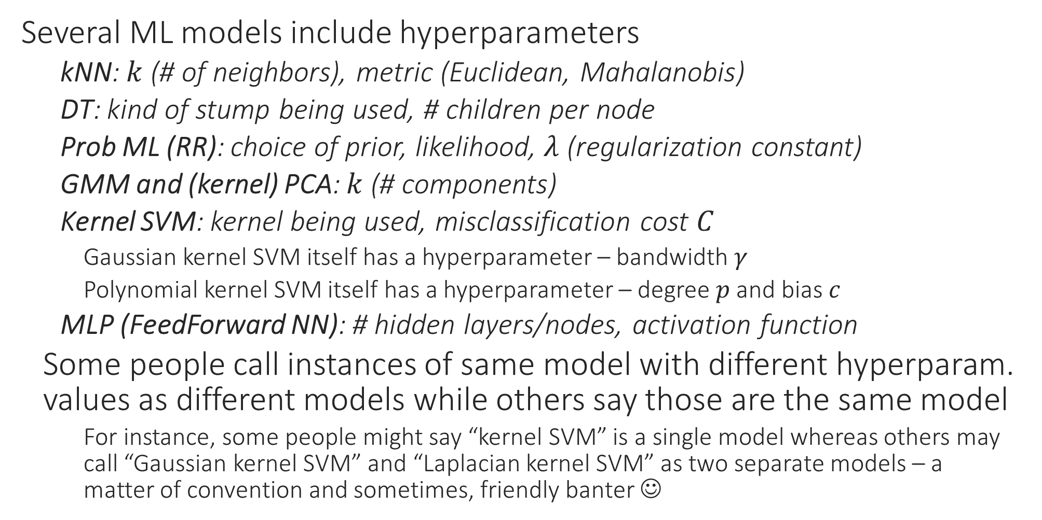
Models in Machine Learning
Several ML models include hyperparameters
kNN: $k$ (# of neighbors), metric (Euclidean, Mahalanobis)
DT: kind of stump being used, # children per node
Prob ML (RR): choice of prior, likelihood, $λ$ (regularization constant)
GMM and (kernel) PCA: $k$ (# components)
Kernel SVM: kernel being used, misclassification cost $C$
Gaussian kernel SVM itself has a hyperparameter – bandwidth $γ$
Polynomial kernel SVM itself has a hyperparameter – degree $p$ and bias $c$
MLP (FeedForward NN): # hidden layers/nodes, activation function
Some people call instances of same model with different hyperparam. values as different models while others say those are the same model
For instance, some people might say “kernel SVM” is a single model whereas others may call “Gaussian kernel SVM” and “Laplacian kernel SVM” as two separate models – a matter of convention and sometimes, friendly banter ☺

Slide 6

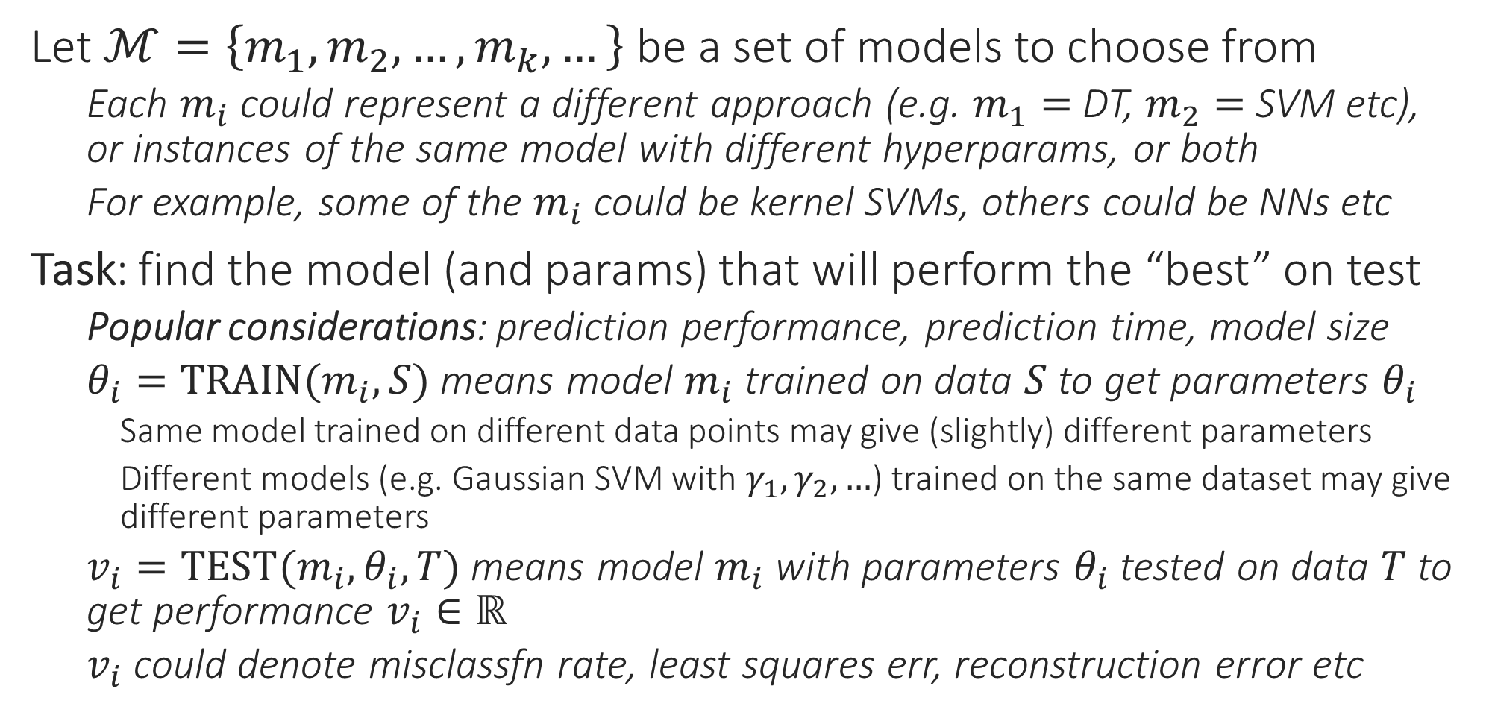
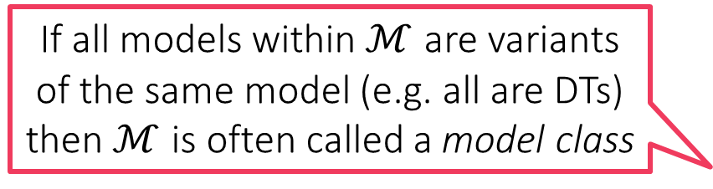
Model Selection
If all models within $ℳ$ are variants of the same model (e.g. all are DTs) then $ℳ$ is often called a model class
Let $ℳ=\left\{m_{1},m_{2},…,m_{k},…\right\}$ be a set of models to choose from
Each $m_{i}$ could represent a different approach (e.g. $m_{1}=$ DT, $m_{2}=$ SVM etc), or instances of the same model with different hyperparams, or both
For example, some of the $m_{i}$ could be kernel SVMs, others could be NNs etc
Task: find the model (and params) that will perform the “best” on test
Popular considerations: prediction performance, prediction time, model size
$θ_{i}=TRAIN(m_{i},S)$ means model $m_{i}$ trained on data $S$ to get parameters $θ_{i}$
Same model trained on different data points may give (slightly) different parameters
Different models (e.g. Gaussian SVM with $γ_{1},γ_{2},…$) trained on the same dataset may give different parameters
$v_{i}=TEST(m_{i},θ_{i},T)$ means model $m_{i}$ with parameters $θ_{i}$ tested on data $T$ to get performance $v_{i}∈ℝ$
$v_{i}$ could denote misclassfn rate, least squares err, reconstruction error etc

Slide 7

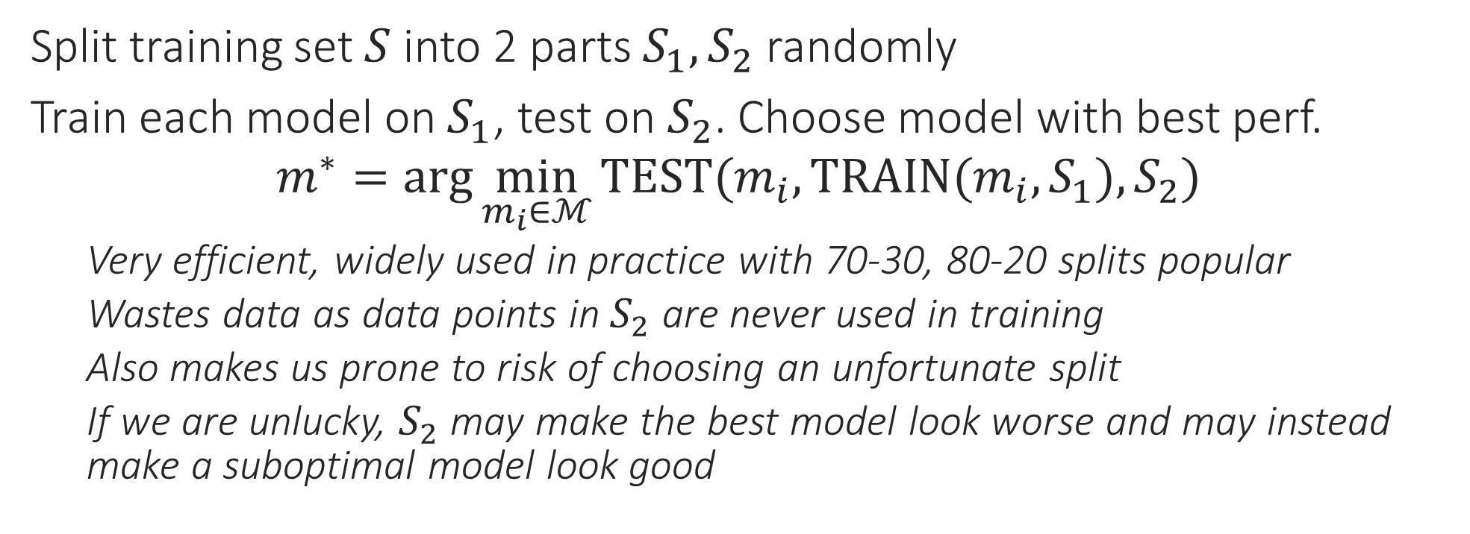


Model Selection 1: Held-out Validation
$$S$$
$$S_{1}$$
$$S_{2}$$
Split training set $S$ into 2 parts $S_{1},S_{2}$ randomly
Train each model on $S_{1}$, test on $S_{2}$. Choose model with best perf.
$$m^{∗}=\arg{\min_{m_{i}∈ℳ}{TEST(m_{i},TRAIN(m_{i},S_{1}),S_{2})}}$$
Very efficient, widely used in practice with 70-30, 80-20 splits popular
Wastes data as data points in $S_{2}$ are never used in training
Also makes us prone to risk of choosing an unfortunate split
If we are unlucky, $S_{2}$ may make the best model look worse and may instead make a suboptimal model look good

Slide 8


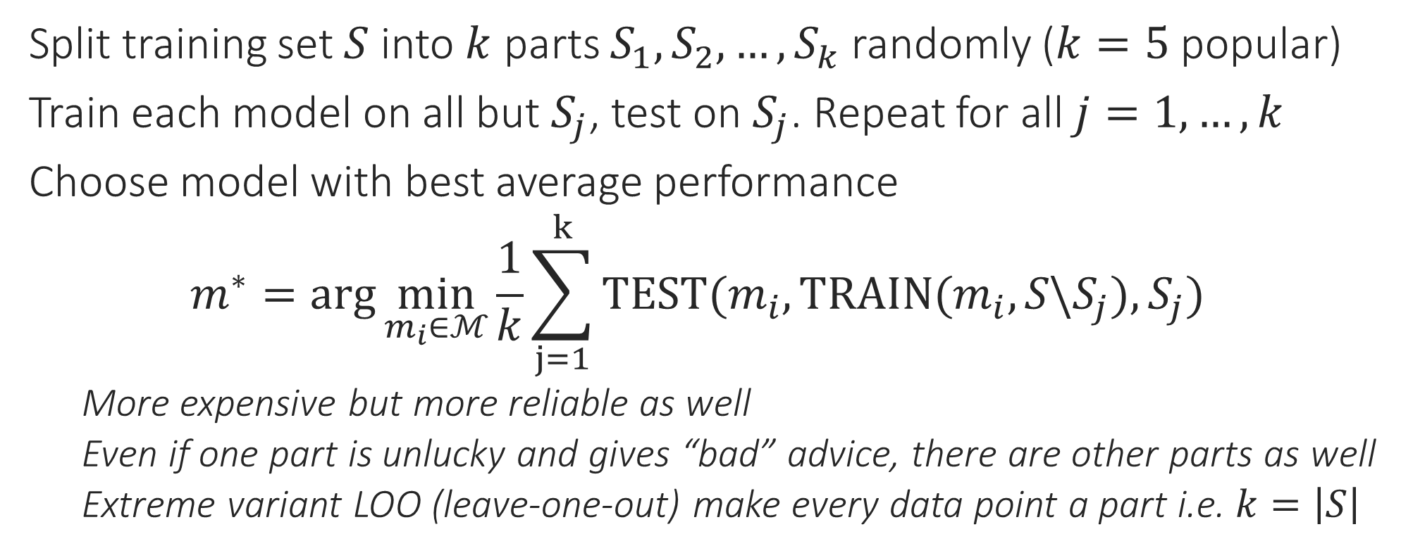






Model Selection 2: $k$-fold Cross Validation
$$S$$
$$S_{1}$$
$$S_{2}$$
$$S_{3}$$
$$S_{4}$$
$$S_{5}$$
Split training set $S$ into $k$ parts $S_{1},S_{2},…,S_{k}$ randomly ($k=5$ popular)
Train each model on all but $S_{j}$, test on $S_{j}$. Repeat for all $j=1,…,k$
Choose model with best average performance
$$m^{∗}=\arg{\min_{m_{i}∈ℳ}{\frac{1}{k}\sum_{j=1}^{k}{TEST(m_{i},TRAIN(m_{i},S\backslash S_{j}),S_{j})}}}$$
More expensive but more reliable as well
Even if one part is unlucky and gives “bad” advice, there are other parts as well
Extreme variant LOO (leave-one-out) make every data point a part i.e. $k=\left|S\right|$
Since training 𝑛 times is super expensive, LOO is popular for algorithms that require no or very less “training” e.g. kNN

Slide 9
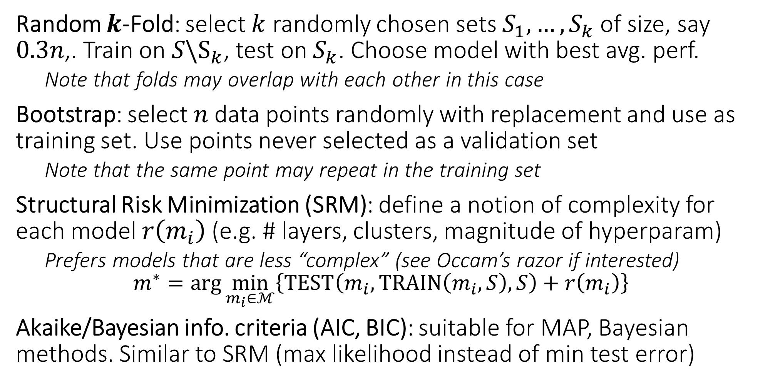
Model Selection: other techniques
Random $k$-Fold: select $k$ randomly chosen sets $S_{1},…,S_{k}$ of size, say $0.3n$,. Train on $S\backslash S_{k}$, test on $S_{k}$. Choose model with best avg. perf.
Note that folds may overlap with each other in this case
Bootstrap: select $n$ data points randomly with replacement and use as training set. Use points never selected as a validation set
Note that the same point may repeat in the training set
Structural Risk Minimization (SRM): define a notion of complexity for each model $r\left(m_{i}\right)$ (e.g. # layers, clusters, magnitude of hyperparam)
Prefers models that are less “complex” (see Occam’s razor if interested) $m^{∗}=\arg{\min_{m_{i}∈ℳ}\left\{TEST\left(m_{i},TRAIN\left(m_{i},S\right),S\right)+r\left(m_{i}\right)\right\}}$
Akaike/Bayesian info. criteria (AIC, BIC): suitable for MAP, Bayesian methods. Similar to SRM (max likelihood instead of min test error)

Slide 10

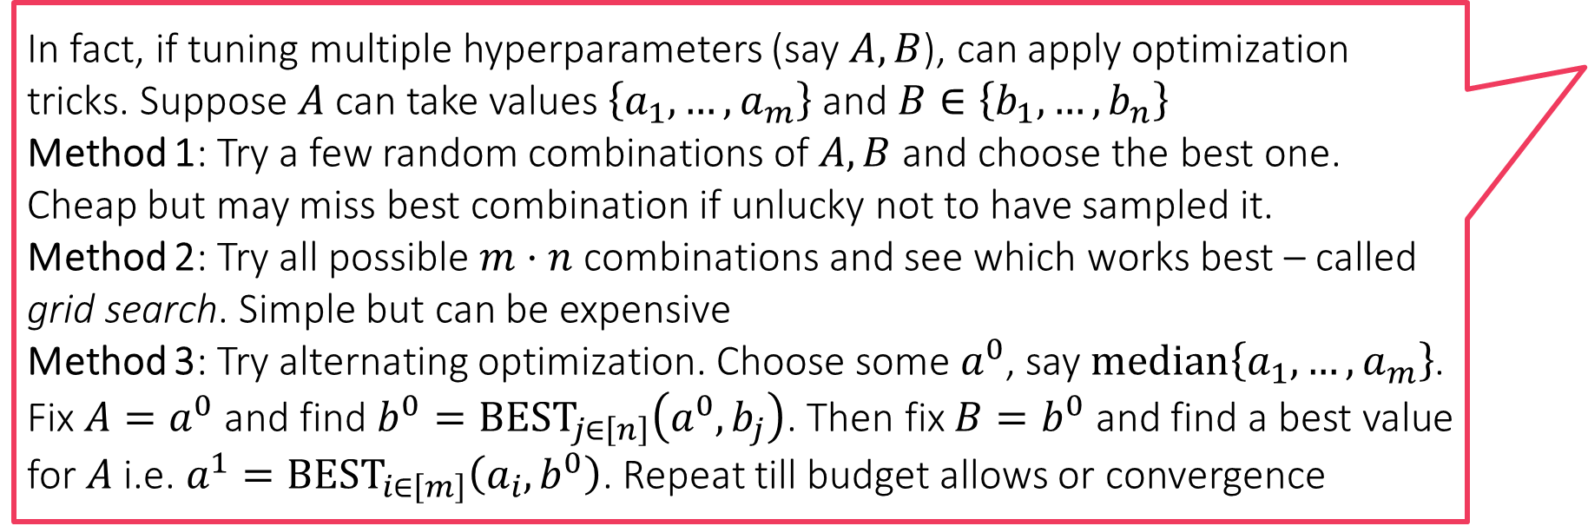
Model Selection: other techniques
In fact, if tuning multiple hyperparameters (say $A,B$), can apply optimization tricks. Suppose $A$ can take values $\left\{a_{1},…,a_{m}\right\}$ and $B∈\left\{b_{1},…,b_{n}\right\}$
Method 1: Try a few random combinations of $A,B$ and choose the best one. Cheap but may miss best combination if unlucky not to have sampled it.
Method 2: Try all possible $m⋅n$ combinations and see which works best – called grid search. Simple but can be expensive
Method 3: Try alternating optimization. Choose some $a^{0}$, say $median\left\{a_{1},…,a_{m}\right\}$. Fix $A=a^{0}$ and find $b^{0}=BEST_{j∈\left[n\right]}\left(a^{0},b_{j}\right)$. Then fix $B=b^{0}$ and find a best value for $A$ i.e. $a^{1}=BEST_{i∈\left[m\right]}\left(a_{i},b^{0}\right)$. Repeat till budget allows or convergence
Bandit Optimization: useful when $ℳ$ is a model class i.e. $m∈ℳ$ given by different hyperparams. View model selection as an optim. problem $m^{∗}=\arg{\min_{m∈ℳ}{f\left(m\right)}}=\arg{\min_{m∈ℳ}{TEST(m,TRAIN(m,S),S)}}$
However, getting “gradients” for the above objective function intractable
Hence cannot request for gradients or Hessians of $f$ while optimizing it
Can only ask for $f\left(⋅\right)$ values on specific models $m^{1},m^{2},…$
Also known as zeroth-order optimization, derivative-free optimization
Bayesian optimization is an example of Bandit optimization
Bayesian Learning: cast model selection as a learning problem!
Establish a prior over the model class $ℳ$ and a likelihood $ℙ\left[S | m\right]$
Perform model learning jointly with parameter learning

Slide 11
Bias Variance Tradeoffs
Models with low bias and low variance are golden but usually they exist only for specific domains (e.g. linear models may do very well in predicting income as a function of education). Expecting low variance and low bias in general is a pipe dream.
Two main sources of bad test performance for ML algos
Bias: model is too weak e.g. linear model for a very complex task
Even the best trained linear model is pathetic
Variance: model is strong but difficult to train it properly e.g. NN
Model very sensitive to training algo or choice of training points
Models with high variance usually are brittle as well
Changing training data even slightly changes the model parameters a lot
Usually models that are weak are also easy to train very accurately
In other words, they exhibit high bias, low variance
Usually models that are strong are more difficult to train too
In other words, they exhibit low-bias, high variance
Need to balance bias and variance in practice
Test Error
Models with high bias and high variance usually useless in the most spectacular way unless they offer other benefits like small model size or small prediction time
Bias
Variance
Variance of most models goes down with more training data or else more effective optimization
Low
Medium
High
Model Complexity

Slide 12
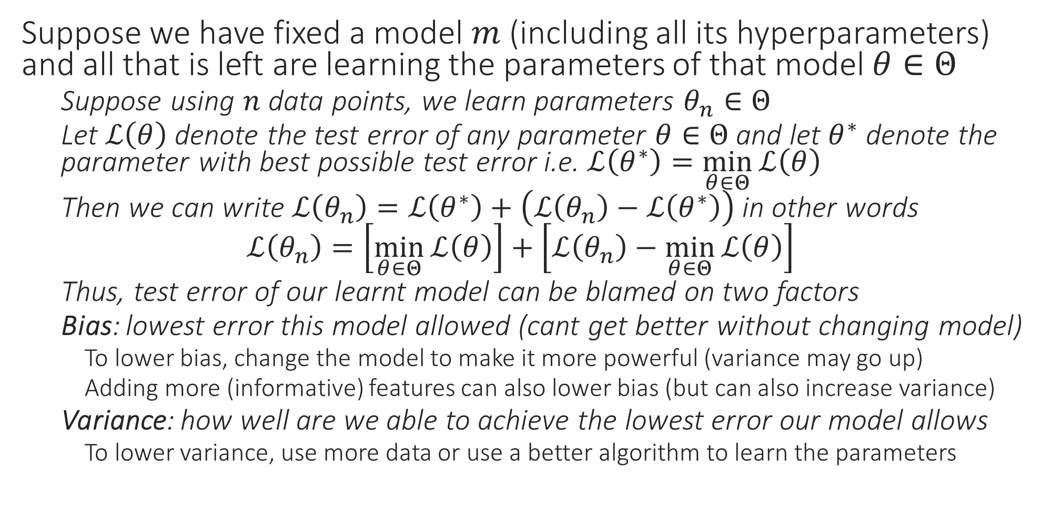
Bias Variance Mathematically
Suppose we have fixed a model $m$ (including all its hyperparameters) and all that is left are learning the parameters of that model $θ∈Θ$
Suppose using $n$ data points, we learn parameters $θ_{n}∈Θ$
Let $ℒ\left(θ\right)$ denote the test error of any parameter $θ∈Θ$ and let $θ^{∗}$ denote the parameter with best possible test error i.e. $ℒ\left(θ^{∗}\right)=\min_{θ∈Θ}{ℒ\left(θ\right)}$
Then we can write $ℒ\left(θ_{n}\right)=ℒ\left(θ^{∗}\right)+\left(ℒ\left(θ_{n}\right)−ℒ\left(θ^{∗}\right)\right)$ in other words
$$ℒ\left(θ_{n}\right)=\left[\min_{θ∈Θ}{ℒ\left(θ\right)}\right]+\left[ℒ\left(θ_{n}\right)−\min_{θ∈Θ}{ℒ\left(θ\right)}\right]$$
Thus, test error of our learnt model can be blamed on two factors
Bias: lowest error this model allowed (cant get better without changing model)
To lower bias, change the model to make it more powerful (variance may go up)
Adding more (informative) features can also lower bias (but can also increase variance)
Variance: how well are we able to achieve the lowest error our model allows
To lower variance, use more data or use a better algorithm to learn the parameters

Slide 13
Generalization Error
Generalization error (just like variance) can usually be brought down by using more data points or choosing models that are simpler
The gap between train and test error rates
Measures how well is the model+parameters able to “generalize” to unseen data
Gen error usually small for models with small complexity (small variance), high for models with high complexity (large variance)
Note: a model with large bias may give very good gen error but high test error
Its test error will be close to train error but both will be very large
Test Error
Difference between variance and gen error is subtle. Model complexity and train set size affect both. However, variance can also be high because of using an improper learning algorithm (or not optimizing properly) but usually algo issues do not affect gen error much.
Underfitting
Overfitting
Gen Error
Training Error
Low
Medium
High
Model Complexity

Slide 14

Detecting Over/underfitting
Adding more data cannot decrease bias. The chosen model just sucks ☹ Adding more data can decrease variance though
Low training error but high test error??
You may have overfit – your model is simply memorizing training data
Your model is clearly powerful enough – does not seem to be a bias problem
Use more data/better optimizer/simpler model (or all) to decrease variance
High training error and high test error??
You may have underfit – your model is incapable of handling the learning task
Increase model class complexity, add better features, to decrease bias
Use more data, better ML algo to address any underlying variance issues
Low training error and low test error
er … about what are you complaining exactly?
High training error and low test error
Maybe you did early stopping which acted as a regularizer – lucky you!
Sometimes may need to iterate through the above experiences (experience high bias, reduce it only to increase variance, then decrease variance etc) before reaching a sweet spot

Slide 15
Ensemble Learning
Notion of voting ensembles to improve performance
Bagged ensembles to reduce variance
Boosted ensembles to reduce bias

Slide 16
Ensemble ML Algorithms
Most real life systems that use ML use not one but several models
Known to be true of industrial models for recommendation, search, ranking
Ensemble: a collection of several ML models working cooperatively
Ensembles have several advantages
Reduce reliance on a single model which may fail at times
Allow us to harness the strengths of a variety of models
Offers users a smooth transition if ensemble needs modification
E.g. if an outdated algo is removed from ensemble or a latest algo is added
If a single model had been used, changing that model could disrupt user experience
Can also be used to address bias-variance issues
Some ensemble techniques can lower bias of weak models (make them more powerful)
Other techniques can lower variance of models (make them stable and less jittery)

Slide 17






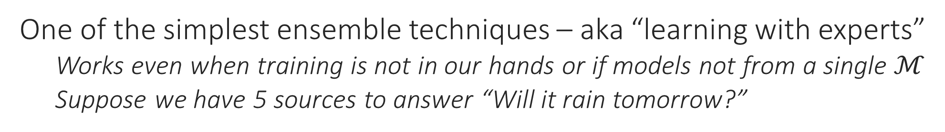
Voting Ensemble
No individual news network gets more than 66% correct predictions but if we take a majority vote, we are 100% correct all the time. The same trick is also popularly used in psephology (“poll of polls”)
One of the simplest ensemble techniques – aka “learning with experts”
Works even when training is not in our hands or if models not from a single $ℳ$
Suppose we have 5 sources to answer “Will it rain tomorrow?”
P
Gold Truth
Correct prediction
Q
N
N
Y
N
Y
Y
Y
Y
Y
Y
N
N
N
N
N
Y
Y
N
Y
N
Y
N
Y
Y
Y
Y
Y
Y
N
N
Y
N
Y
Y
Y
N
Incorrect prediction

Slide 18
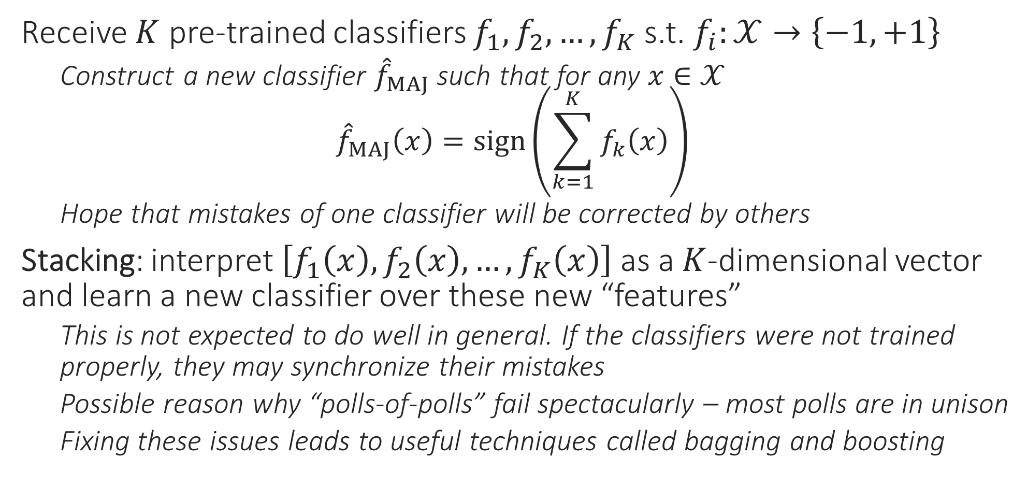
Voting Ensembles
Need to ensure experts are diverse so that they can correct each other’s errors. Bagging and boosting take direct steps to ensure this
Receive $K$ pre-trained classifiers $f_{1},f_{2},…,f_{K}$ s.t. $f_{i}:𝒳→\left\{−1,+1\right\}$
Construct a new classifier ${\hat{f}}_{MAJ}$ such that for any $x∈𝒳$ ${\hat{f}}_{MAJ}\left(x\right)=sign\left(\sum_{k=1}^{K}{f_{k}\left(x\right)}\right)$
Hope that mistakes of one classifier will be corrected by others
Stacking: interpret $\left[f_{1}\left(x\right),f_{2}\left(x\right),…,f_{K}\left(x\right)\right]$ as a $K$-dimensional vector and learn a new classifier over these new “features”
This is not expected to do well in general. If the classifiers were not trained properly, they may synchronize their mistakes
Possible reason why “polls-of-polls” fail spectacularly – most polls are in unison
Fixing these issues leads to useful techniques called bagging and boosting

Slide 19
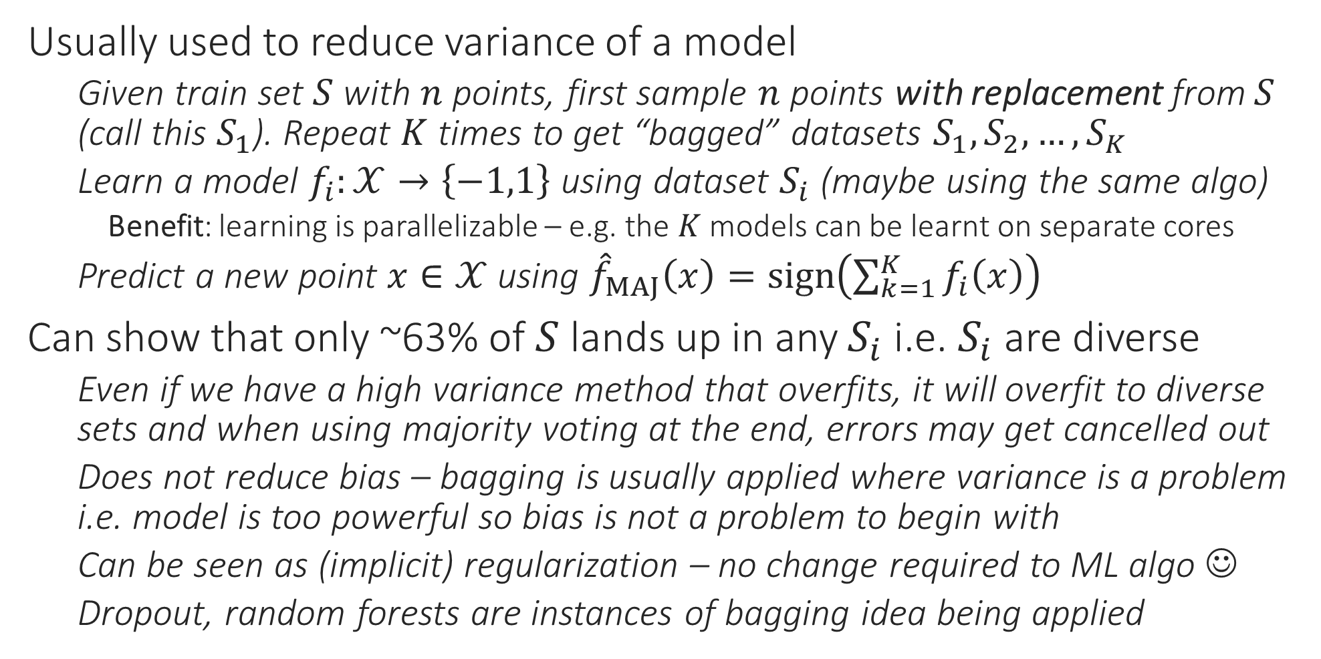
Bagging – Bootstrap AGGregatING
Usually used to reduce variance of a model
Given train set $S$ with $n$ points, first sample $n$ points with replacement from $S$ (call this $S_{1}$). Repeat $K$ times to get “bagged” datasets $S_{1},S_{2},…,S_{K}$
Learn a model $f_{i}:𝒳→\left\{−1,1\right\}$ using dataset $S_{i}$ (maybe using the same algo)
Benefit: learning is parallelizable – e.g. the $K$ models can be learnt on separate cores
Predict a new point $x∈𝒳$ using ${\hat{f}}_{MAJ}\left(x\right)=sign\left(\sum_{k=1}^{K}{f_{i}\left(x\right)}\right)$
Can show that only ~63% of $S$ lands up in any $S_{i}$ i.e. $S_{i}$ are diverse
Even if we have a high variance method that overfits, it will overfit to diverse sets and when using majority voting at the end, errors may get cancelled out
Does not reduce bias – bagging is usually applied where variance is a problem i.e. model is too powerful so bias is not a problem to begin with
Can be seen as (implicit) regularization – no change required to ML algo ☺
Dropout, random forests are instances of bagging idea being applied

Slide 20
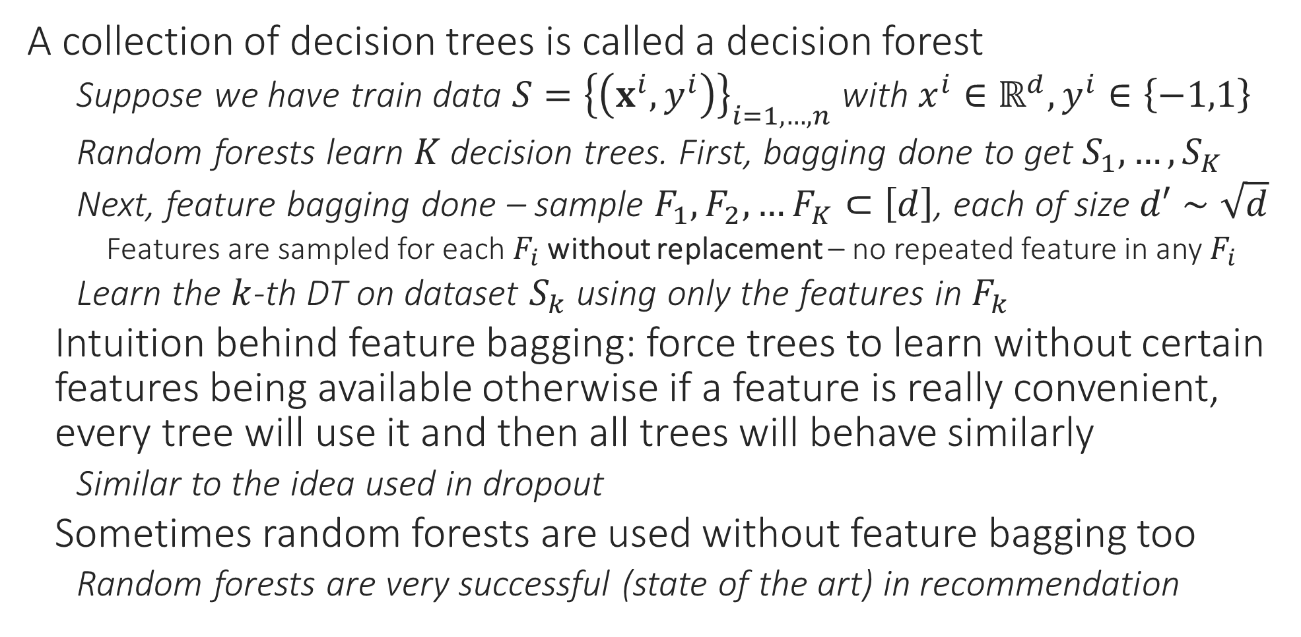
Random Forests
A collection of decision trees is called a decision forest
Suppose we have train data $S={\left\{\left(x^{i},y^{i}\right)\right\}}_{i=1,…,n}$ with $x^{i}∈ℝ^{d},y^{i}∈\left\{−1,1\right\}$
Random forests learn $K$ decision trees. First, bagging done to get $S_{1},…,S_{K}$
Next, feature bagging done – sample $F_{1},F_{2},…F_{K}⊂\left[d\right]$, each of size $d′∼\sqrt{d}$
Features are sampled for each $F_{i}$ without replacement – no repeated feature in any $F_{i}$
Learn the $k$-th DT on dataset $S_{k}$ using only the features in $F_{k}$
Intuition behind feature bagging: force trees to learn without certain features being available otherwise if a feature is really convenient, every tree will use it and then all trees will behave similarly
Similar to the idea used in dropout
Sometimes random forests are used without feature bagging too
Random forests are very successful (state of the art) in recommendation

Slide 21
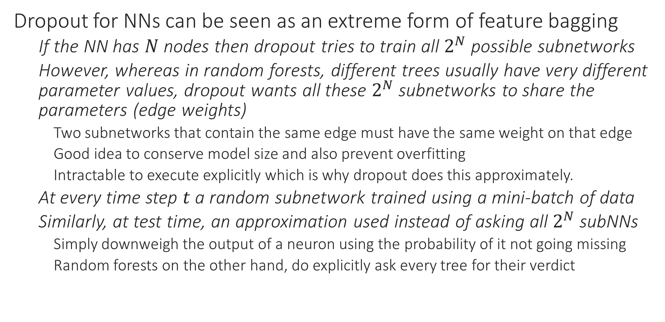
Dropout
Dropout for NNs can be seen as an extreme form of feature bagging
If the NN has $N$ nodes then dropout tries to train all $2^{N}$ possible subnetworks
However, whereas in random forests, different trees usually have very different parameter values, dropout wants all these $2^{N}$ subnetworks to share the parameters (edge weights)
Two subnetworks that contain the same edge must have the same weight on that edge
Good idea to conserve model size and also prevent overfitting
Intractable to execute explicitly which is why dropout does this approximately.
At every time step $t$ a random subnetwork trained using a mini-batch of data
Similarly, at test time, an approximation used instead of asking all $2^{N}$ subNNs
Simply downweigh the output of a neuron using the probability of it not going missing
Random forests on the other hand, do explicitly ask every tree for their verdict

Slide 22
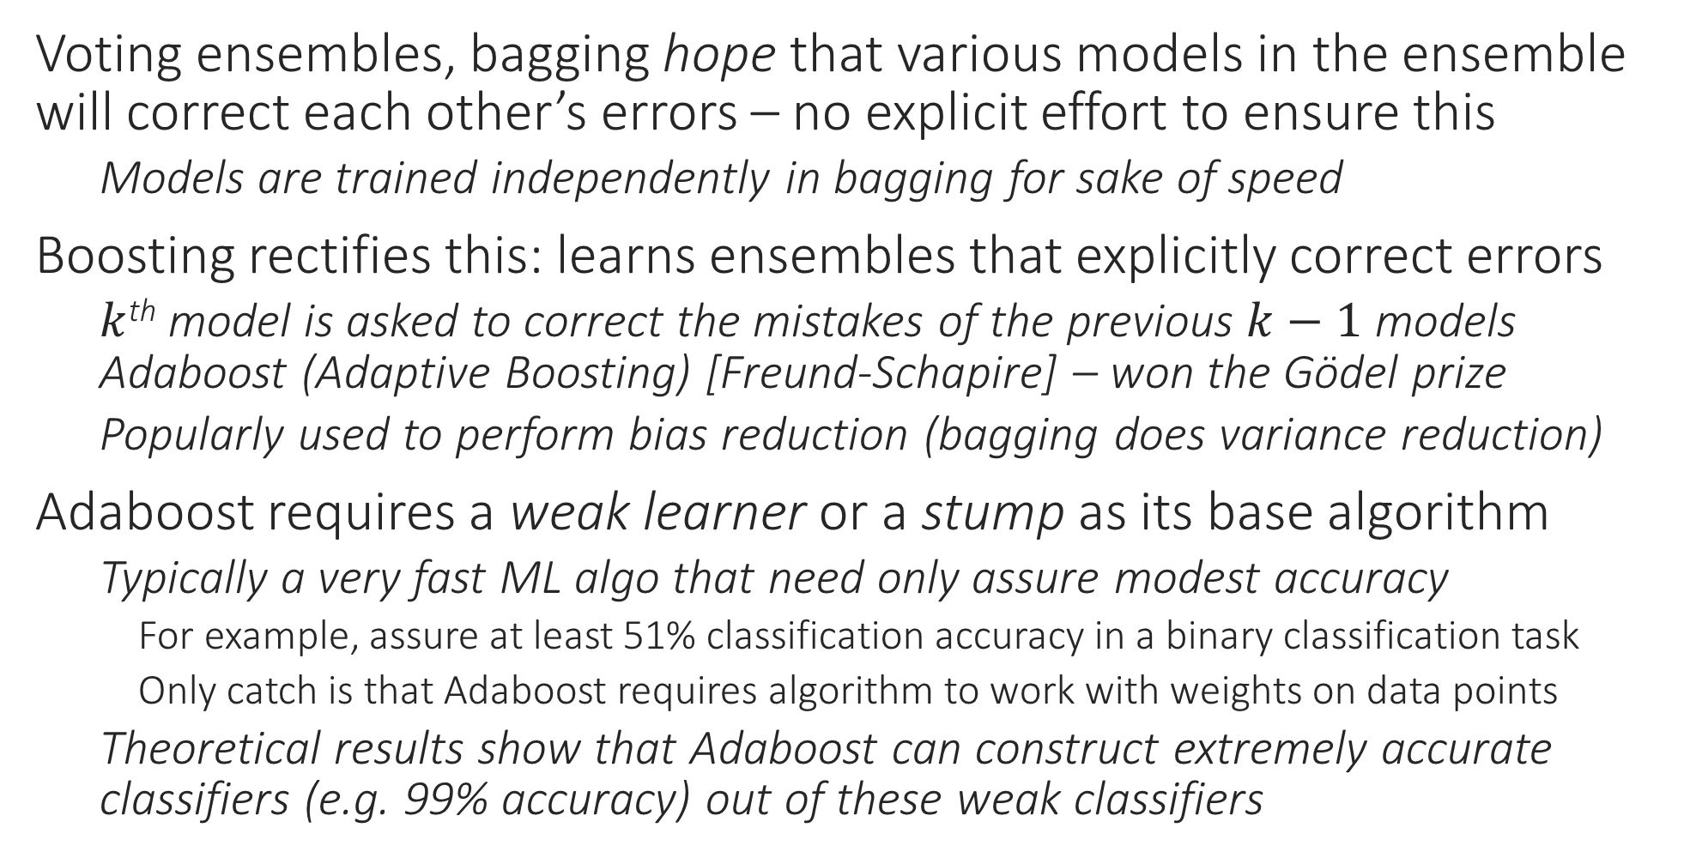

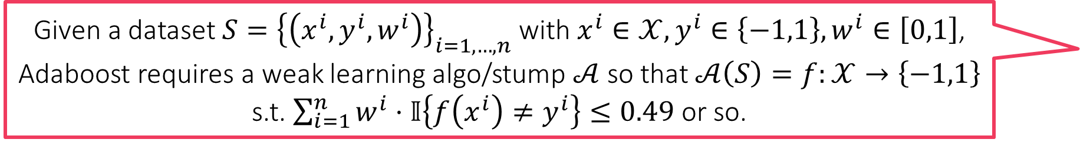
Boosting
Given a dataset $S={\left\{\left(x^{i},y^{i},w^{i}\right)\right\}}_{i=1,…,n}$ with $x^{i}∈𝒳,y^{i}∈\left\{−1,1\right\},w^{i}∈\left[0,1\right]$, Adaboost requires a weak learning algo/stump $𝒜$ so that $𝒜\left(S\right)=f:𝒳→\left\{−1,1\right\}$ s.t. $\sum_{i=1}^{n}{w^{i}⋅𝕀\left\{f\left(x^{i}\right)≠y^{i}\right\}}≤0.49$ or so.
Voting ensembles, bagging hope that various models in the ensemble will correct each other’s errors – no explicit effort to ensure this
Models are trained independently in bagging for sake of speed
Boosting rectifies this: learns ensembles that explicitly correct errors
$k$^{th} model is asked to correct the mistakes of the previous $k−1$ models Adaboost (Adaptive Boosting) [Freund-Schapire] – won the Gödel prize
Popularly used to perform bias reduction (bagging does variance reduction)
Adaboost requires a weak learner or a stump as its base algorithm
Typically a very fast ML algo that need only assure modest accuracy
For example, assure at least 51% classification accuracy in a binary classification task
Only catch is that Adaboost requires algorithm to work with weights on data points
Theoretical results show that Adaboost can construct extremely accurate classifiers (e.g. 99% accuracy) out of these weak classifiers
Adaboost typically not used with strong learners e.g. an 18 layer deep CNN since
Powerful models usually have tiny bias (can even memorize data) – problem with powerful models is variance and not bias
Training usually NP-hard, time consuming for such powerful models

Slide 23
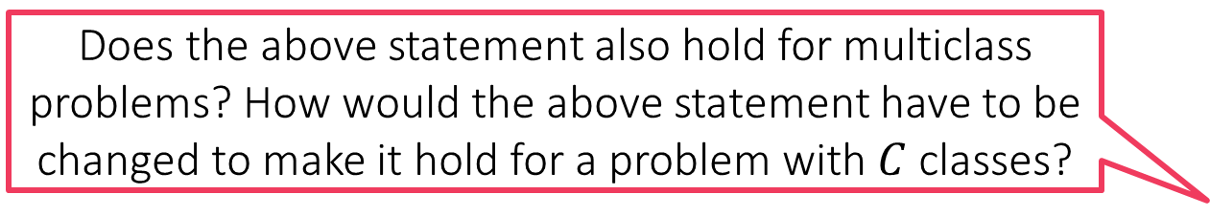

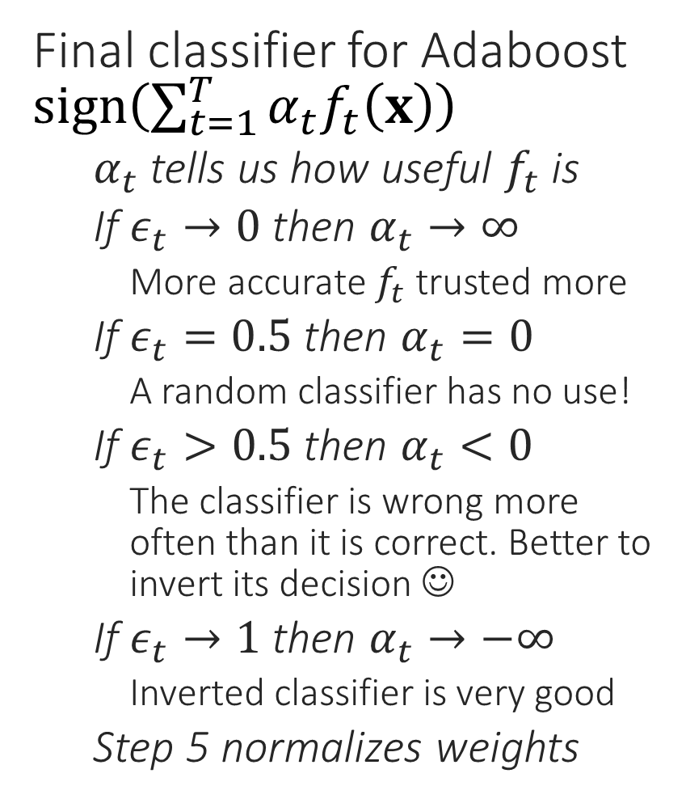


AdaBoost
$$α$$
For binary classification, we can trivially get more than 50% accuracy by just predict the more common of the two labels. A classifier that gets 1% accuracy is actually very good since its inverted form will get 99% accuracy
ADABOOST
Data $S={\left\{\left(x^{i},y^{i}\right)\right\}}_{i=1,…,n}$, stump learner
Assign initial weights $w^{i}=\frac{1}{n}$ for $i∈\left[n\right]$
For $t=1,2,…$
Use $\left(S,\left\{w^{i}\right\}\right)$ to learn $f_{t}:𝒳→\{−1,1\}$
Let $ε_{t}←\sum_{i=1}^{n}{w^{i}⋅}𝕀\left\{f_{t}\left(x^{i}\right)≠y^{i}\right\}$
Let $α_{t}←\frac{1}{2}⋅\log\left(\frac{1−ε_{t}}{ε_{t}}\right)$
For each data point $i=1,2,…,n$
Let $u^{i}←w^{i}⋅\exp\left(−α_{t}y^{i}f_{t}\left(x^{i}\right)\right)$
Let $w^{i}←{u^{i}}/{\sum_{j}{u^{j}}}$
Repeat until convergence
Final classifier for Adaboost $sign\left(\sum_{t=1}^{T}{α_{t}f_{t}\left(x\right)}\right)$
$α_{t}$ tells us how useful $f_{t}$ is
If $ε_{t}→0$ then $α_{t}→∞$
More accurate $f_{t}$ trusted more
If $ε_{t}=0.5$ then $α_{t}=0$
A random classifier has no use!
If $ε_{t}>0.5$ then $α_{t}<0$
The classifier is wrong more often than it is correct. Better to invert its decision ☺
If $ε_{t}→1$ then $α_{t}→−∞$
Inverted classifier is very good
Step 5 normalizes weights
0
1
$$ε$$
Does the above statement also hold for multiclass problems? How would the above statement have to be changed to make it hold for a problem with $C$ classes?

Slide 24
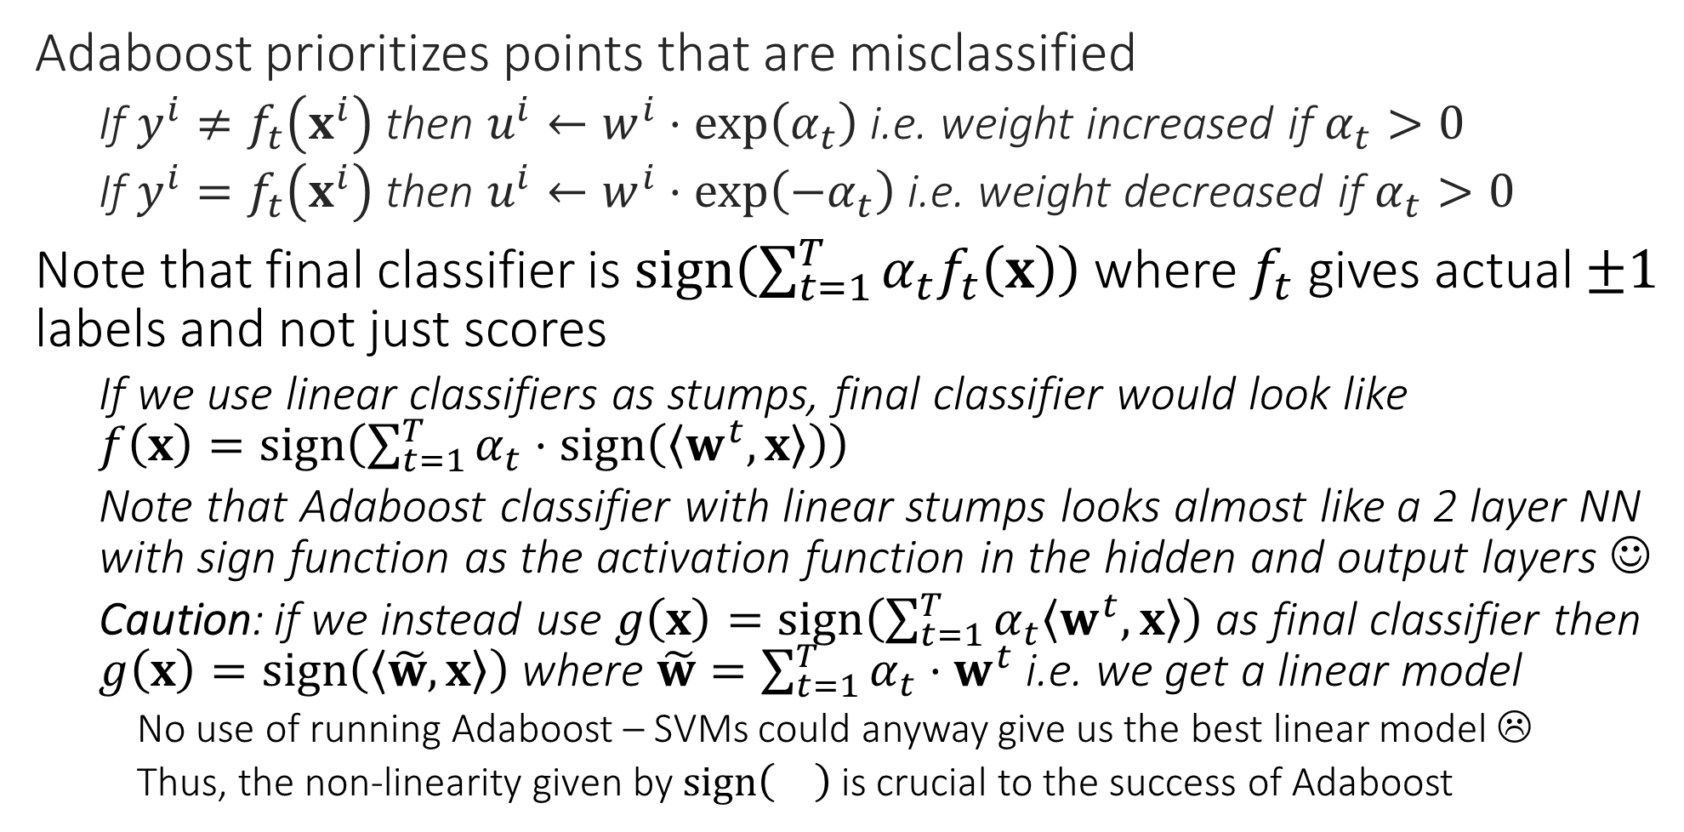
Adaboost
Adaboost prioritizes points that are misclassified
If $y^{i}≠f_{t}\left(x^{i}\right)$ then $u^{i}←w^{i}⋅\exp\left(α_{t}\right)$ i.e. weight increased if $α_{t}>0$
If $y^{i}=f_{t}\left(x^{i}\right)$ then $u^{i}←w^{i}⋅\exp\left(−α_{t}\right)$ i.e. weight decreased if $α_{t}>0$
Note that final classifier is $sign\left(\sum_{t=1}^{T}{α_{t}f_{t}\left(x\right)}\right)$ where $f_{t}$ gives actual $±1$ labels and not just scores
If we use linear classifiers as stumps, final classifier would look like $f\left(x\right)=sign\left(\sum_{t=1}^{T}{α_{t}⋅sign\left(\left\langle w^{t},x\right\rangle \right)}\right)$
Note that Adaboost classifier with linear stumps looks almost like a 2 layer NN with sign function as the activation function in the hidden and output layers ☺
Caution: if we instead use $g\left(x\right)=sign\left(\sum_{t=1}^{T}{α_{t}\left\langle w^{t},x\right\rangle }\right)$ as final classifier then $g\left(x\right)=sign\left(\left\langle \tilde{w},x\right\rangle \right)$ where $\tilde{w}=\sum_{t=1}^{T}{α_{t}⋅w^{t}}$ i.e. we get a linear model
No use of running Adaboost – SVMs could anyway give us the best linear model ☹
Thus, the non-linearity given by $sign\left(\right)$ is crucial to the success of Adaboost

Slide 25
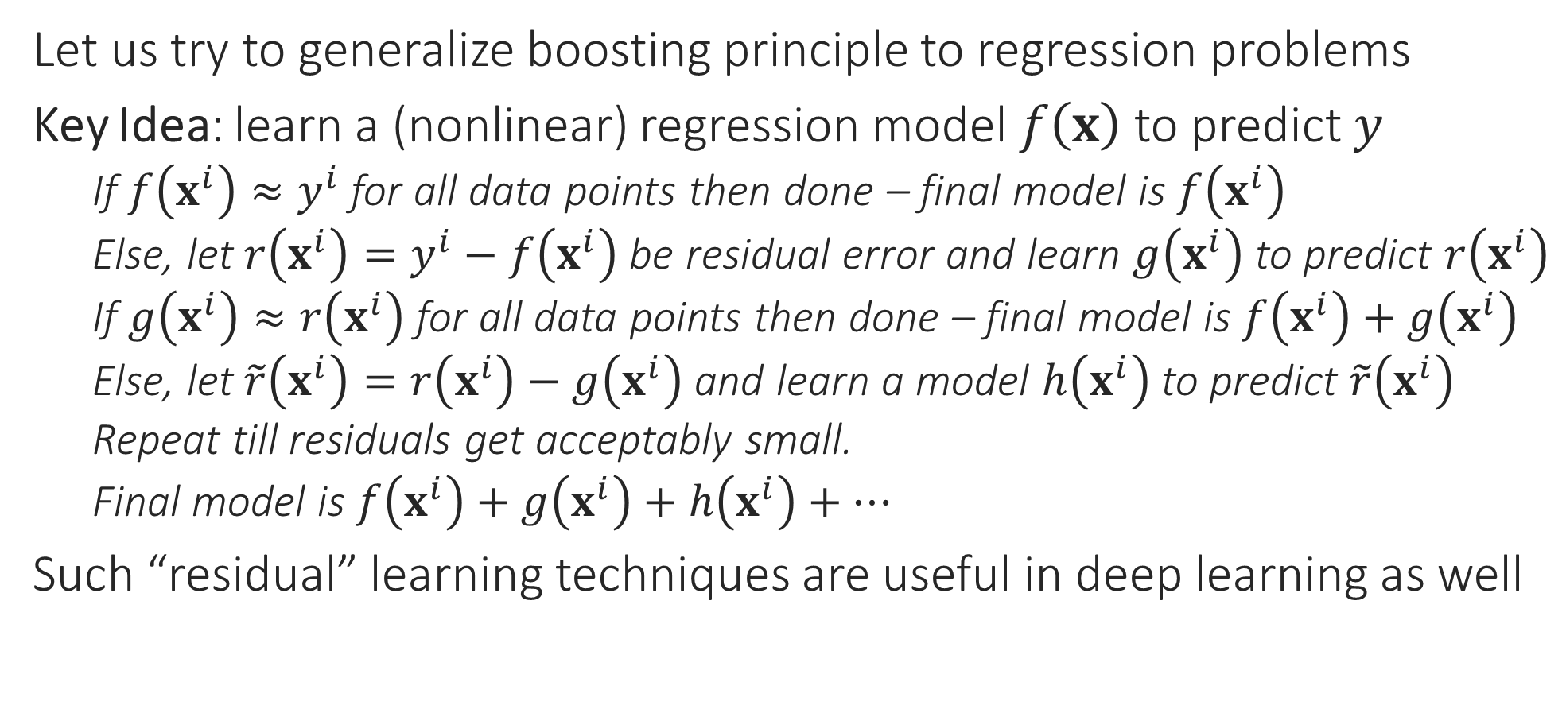
Boosting for Regression?
Let us try to generalize boosting principle to regression problems
Key Idea: learn a (nonlinear) regression model $f\left(x\right)$ to predict $y$
If $f\left(x^{i}\right)≈y^{i}$ for all data points then done – final model is $f\left(x^{i}\right)$
Else, let $r\left(x^{i}\right)=y^{i}−f\left(x^{i}\right)$ be residual error and learn $g\left(x^{i}\right)$ to predict $r\left(x^{i}\right)$
If $g\left(x^{i}\right)≈r\left(x^{i}\right)$ for all data points then done – final model is $f\left(x^{i}\right)+g\left(x^{i}\right)$
Else, let $\tilde{r}\left(x^{i}\right)=r\left(x^{i}\right)−g\left(x^{i}\right)$ and learn a model $h\left(x^{i}\right)$ to predict $\tilde{r}\left(x^{i}\right)$
Repeat till residuals get acceptably small.
Final model is $f\left(x^{i}\right)+g\left(x^{i}\right)+h\left(x^{i}\right)+…$
Such “residual” learning techniques are useful in deep learning as well

Slide 26
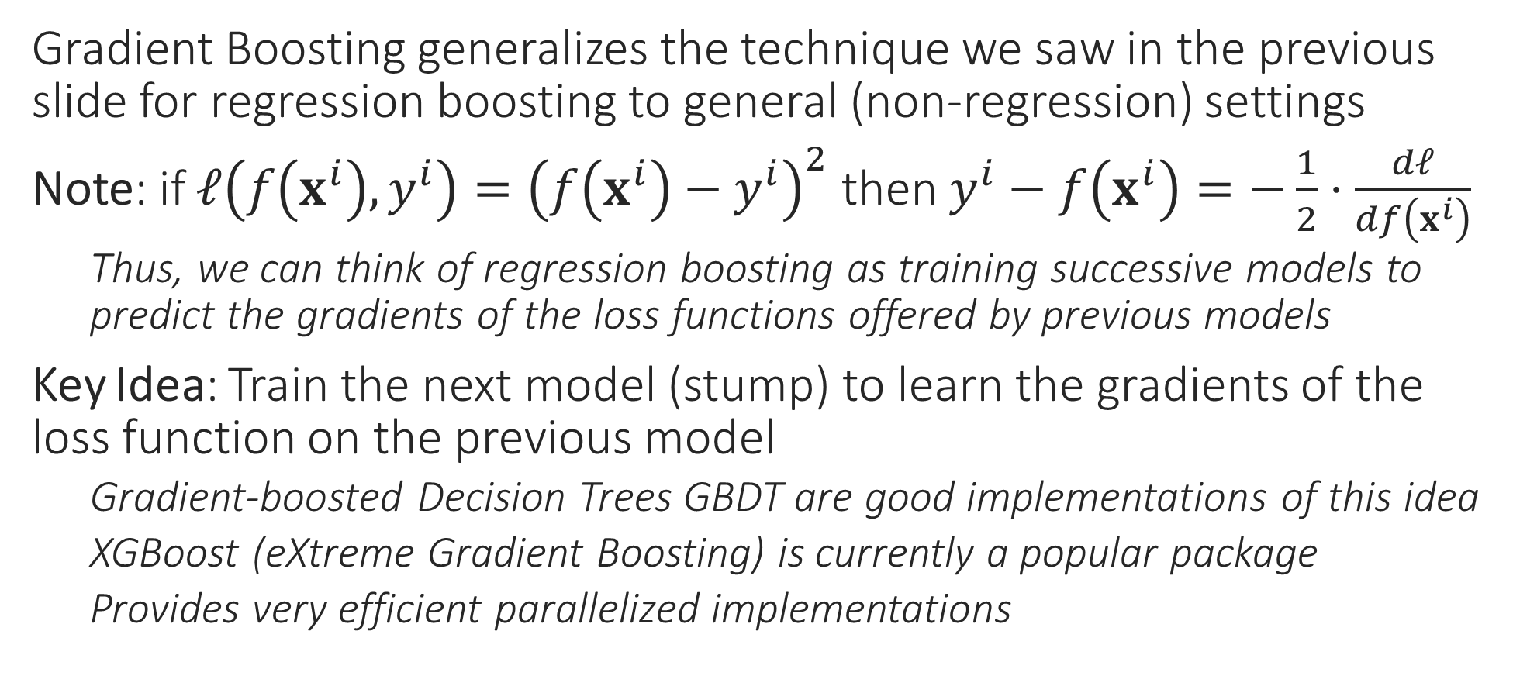
Gradient Boosting
Gradient Boosting generalizes the technique we saw in the previous slide for regression boosting to general (non-regression) settings
Note: if $ℓ\left(f\left(x^{i}\right),y^{i}\right)={\left(f\left(x^{i}\right)−y^{i}\right)}^{2}$ then $y^{i}−f\left(x^{i}\right)=−\frac{1}{2}⋅\frac{dℓ}{df\left(x^{i}\right)}$
Thus, we can think of regression boosting as training successive models to predict the gradients of the loss functions offered by previous models
Key Idea: Train the next model (stump) to learn the gradients of the loss function on the previous model
Gradient-boosted Decision Trees GBDT are good implementations of this idea
XGBoost (eXtreme Gradient Boosting) is currently a popular package
Provides very efficient parallelized implementations

Slide 27

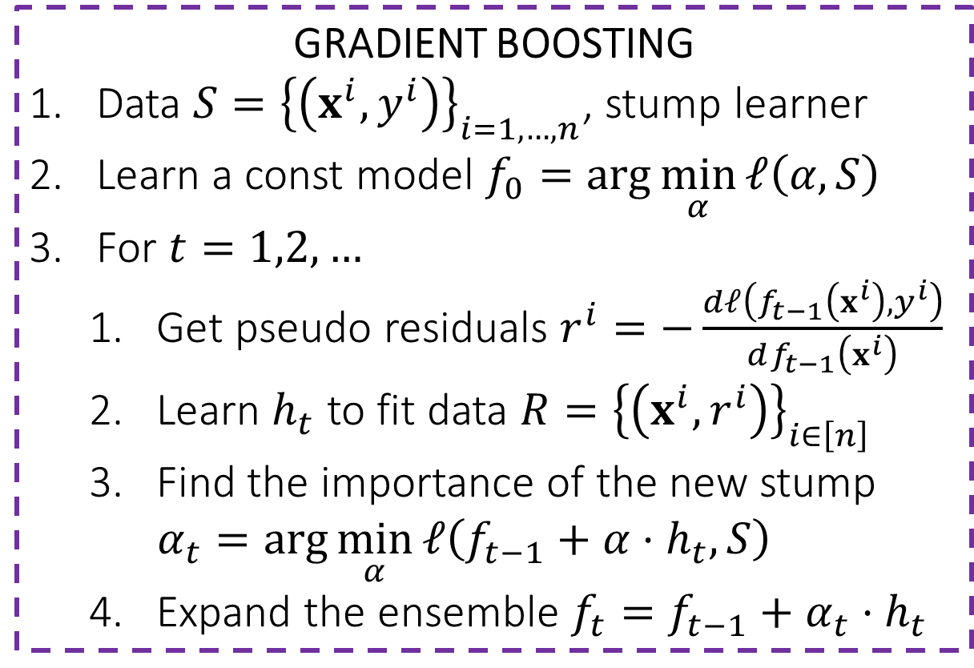
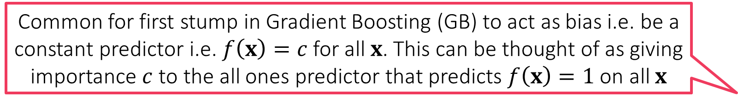
Gradient Boosting
Common for first stump in Gradient Boosting (GB) to act as bias i.e. be a constant predictor i.e. $f\left(x\right)=c$ for all $x$. This can be thought of as giving importance $c$ to the all ones predictor that predicts $f\left(x\right)=1$ on all $x$
GB secretly tries to do GD ☺
If possible, it would’ve done $f_{t}=f_{t−1}−η_{t}⋅{\left.\frac{dℓ}{df}\right]}_{f_{t−1}}$
Since taking gradients w.r.t functions is intractable, GB settles for an approximation
Approx. ${−\left.dℓ/df\right]}_{f_{t−1}}$using $h_{t}$
Search for best step length $η_{t}$
Step 3 does this implicitly
The final ensemble is actually the result of approximate GD in the function space!
GRADIENT BOOSTING
Data $S={\left\{\left(x^{i},y^{i}\right)\right\}}_{i=1,…,n}$, stump learner
Learn a const model $f_{0}=\arg{\min_{α}{ℓ\left(α,S\right)}}$
For $t=1,2,…$
Get pseudo residuals $r^{i}=−\frac{dℓ\left(f_{t−1}\left(x^{i}\right),y^{i}\right)}{df_{t−1}\left(x^{i}\right)}$
Learn $h_{t}$ to fit data $R={\left\{\left(x^{i},r^{i}\right)\right\}}_{i∈\left[n\right]}$
Find the importance of the new stump $α_{t}=\arg{\min_{α}{ℓ\left(f_{t−1}+α⋅h_{t},S\right)}}$
Expand the ensemble $f_{t}=f_{t−1}+α_{t}⋅h_{t}$
Gradient of the loss function would be large on data points which are experiencing large loss so GB would pay more attention to them while learning the next stump – similar intuition as Adaboost had

